Slide 1
Grid
2025
Poornima

Slide 2
Selenium Grid
Selenium Grid is a testing tool that is part of the Selenium Suite, designed to facilitate the execution of automated web application tests across multiple browsers, operating systems, and machines in parallel. This capability is crucial for ensuring that web applications function correctly across diverse user environments.
Key Components and Functionality:
Hub: The central server that manages and controls the test execution. It receives test requests from clients and distributes them to appropriate nodes based on the specified browser and operating system capabilities.
Nodes: Remote machines connected to the hub, where the actual test execution takes place. Each node is configured to run tests on specific browsers and operating systems.
Parallel Execution: Selenium Grid allows for the simultaneous execution of multiple test cases on different nodes, significantly reducing the overall test execution time.
Cross-Browser and Cross-Platform Testing: It enables testing across various browser versions (Chrome, Firefox, Edge, Safari, etc.) and operating systems (Windows, macOS, Linux), ensuring broad compatibility.
Distributed Testing: The hub and nodes can be located on different machines within a network, creating a distributed testing environment.

Slide 3
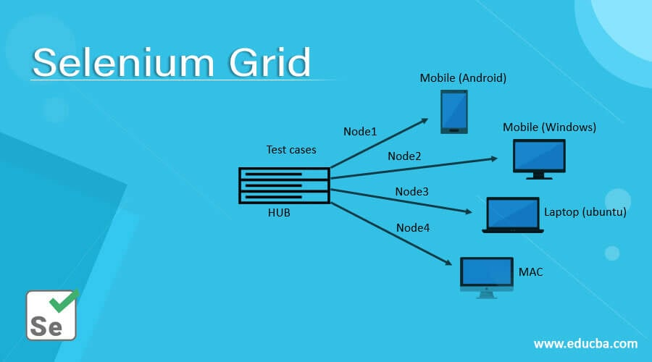
Selenium Grid
How it Works:
A client sends a test request to the hub, specifying the desired browser and operating system.
The hub identifies an available node that matches the requested capabilities.
The hub routes the test commands to the chosen node.
The node executes the test on the specified browser and operating system.
Test results are reported back to the client.

Slide 4
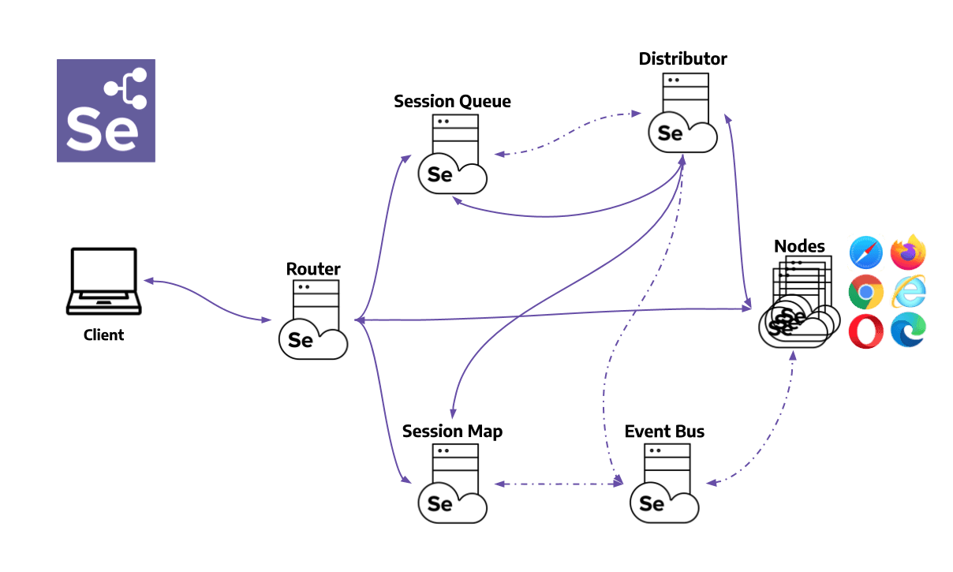
Selenium 4 Architecture
Router: Acts as the entry point for all requests. It determines whether a request is for an existing session or a new one. For existing sessions, it queries the Session Map to route the request to the appropriate Node. For new sessions, it forwards the request to the New Session Queue.
Distributor: Responsible for assigning new session requests to Nodes. It maintains a model of available Nodes and their capabilities. When a Node registers, the Distributor acknowledges it and updates its state to ensure proper session allocation.
Session Map: Maintains a mapping between session IDs and the Nodes where the sessions are running. This allows the Router to efficiently direct requests to the correct Node.
New Session Queue: Handles incoming session requests in a first-come, first-serve manner. It ensures that requests are processed only if they haven't timed out. The Distributor polls this queue to assign sessions to Nodes.
Event Bus: Facilitates asynchronous communication between components like the Distributor, Nodes, and Session Map. It reduces the overhead of HTTP calls by enabling lightweight event-based messaging.
Node: Executes the test sessions. Each Node can have multiple slots, which represent the capacity to run concurrent sessions. Nodes register themselves with the Distributor and send periodic heartbeat signals to indicate their status.

Slide 5
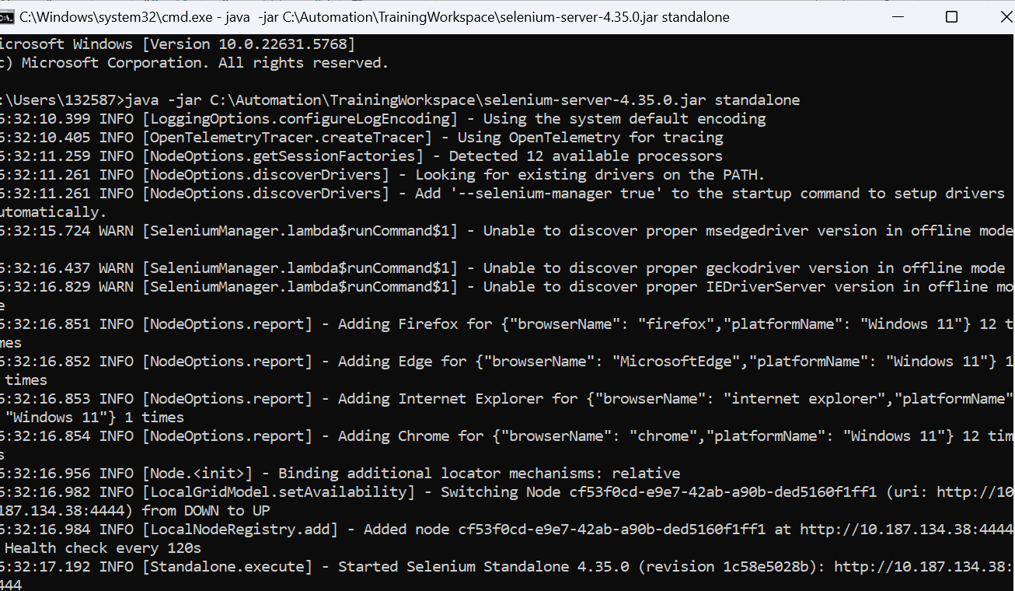
How to run Selenium Grid?
Standalone Setup (Single machine):
Download selenium-server-4.39.0.jar and place it somewhere.
Run below command to start Selenium Grid
java -jar /path/selenium-server-4.39.0.jar standalone
URL to see sessions: http://localhost:4444/
Hub & Node Setup (Multiple machines):
Download selenium-server-4.39.0.jar and place it somewhere in both (hub & node) the machines.
Run below command to make machine as hub
java -jar selenium-server-4.39.0.jar hub
Run below command to make machine as node
java -jar selenium-server-4.39.0.jar node --hub http://<hub-ip>:4444
Example:
java -jar ‘/path/selenium-server-4.39.0.jar' node –hub http://<hubip>:4444 --selenium-manager true
URL to see sessions: http://localhost:4444/

Slide 6
DOCKER
Docker is a platform that makes it easy to build, package, and run applications inside containers.
Containers are lightweight, portable environments that isolate applications and their dependencies, ensuring they run consistently across different systems
Docker is the most widely used platform for building, managing, and running containers. It provides tools and a platform to manage the entire lifecycle of containers, including:
Building Images: Docker uses Dockerfiles, which are text-based instructions, to create Docker Images. An image is a read-only template containing the blueprint for a container.
Running Containers: Docker Engine is the runtime that executes Docker Images, turning them into running containers.
Managing Containers: Docker provides commands to start, stop, pause, resume, and delete containers.
Sharing Images: Docker Hub is a cloud-based registry service for sharing and managing Docker images

Slide 7
Container
Containers are standardized, executable units of software that package up code and all its dependencies, including runtime, libraries, and system tools.
This ensures that the application runs quickly and reliably from one computing environment to another, regardless of differences in infrastructure.
Containers are lightweight and isolated, sharing the host system's kernel but providing a separate, self-contained environment for the application.
A container is a running instance of a Docker Image.

Slide 8
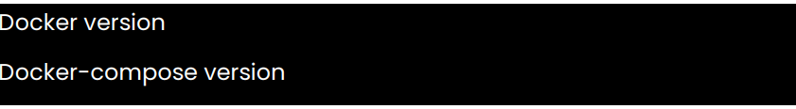
DOCKER
Step 1: Download & Install Docker https://www.docker.com/products/docker-desktop/
Step 2: Verify Installation of Docker
Images Commands
docker images - Lists all the Docker images present on the machine.
docker pull - Pulls an image from a Docker registry. You can find Docker images here: https://hub.docker.com/search?q=&type=image • Example: docker pull ubuntu
docker rmi - Removes Docker images.
docker images -q: Lists image IDs
docker rmi : Deletes the specified image.
After deletion, confirm with docker images
Basic Commands
docker version - Displays the Docker version installed on the system.
docker -v - Short form of docker version. It shows the Docker version.
docker info - Provides detailed information about the Docker installation.
docker --help - Displays general help information.
Example: To get information about specific commands:
docker images --help: Details about managing images.
docker run --help: Details about running containers.
docker login - Logs into a Docker registry, such as Docker Hub. Used for push or pull docker images from Docker Hub
Container Commands
docker ps & docker run
docker ps: Lists running containers.
docker run : Creates a container from a specified image. If local image is not available then it will pull from Docker Hub automatically. • Example: docker run ubuntu. • Example: docker run -it ubuntu //For interaction
docker start - Starts a stopped container. Example: docker start <container id>
docker stop - Stops a running container. Example: docker stop <container id>
docker rm - Removes a container Example: docker rm <container id or name>

Slide 9
Selenium Grid Setup with Docker Containers
Pull Docker Images
Pull Selenium-hub image using command docker pull selenium/hub
Pull FireFox image using command docker pull selenium/node-firefox
Pull Chrome image using below command docker pull selenium/node-chrome
Verify Images
docker images
Selenium Grid Setup with docker-compose.yaml file
1. Create a file docker-compose.yaml with Required config (Ref: https://github.com/SeleniumHQ/dockerselenium)
docker-compose.yaml
version: '3’
services:
selenium-hub:
Image: selenium/hub
ports:
- "4442-4444:4442-4444"
networks:
- grid
node-chrome:
image: selenium/node-chrome environment:
SE_EVENT_BUS_HOST=selenium-hub
SE_EVENT_BUS_PUBLISH_PORT=4442
SE_EVENT_BUS_SUBSCRIBE_PORT=4443
networks:
- grid
node-firefox:
image: selenium/node-firefox environment:
- SE_EVENT_BUS_HOST=selenium-hub
- SE_EVENT_BUS_PUBLISH_PORT=4442
- SE_EVENT_BUS_SUBSCRIBE_PORT=4443 networks: - grid networks: grid: driver: bridge
2. Run docker-compose.yaml docker-compose up
3. To check hub & nodes running state: http://localhost:4444/grid/console
4. To stop the grid and cleanup the created containers: docker-compose down
Running Docker Containers by using below command
docker network create grid
docker run -d -p 4442-4444:4442-4444 --net grid --name selenium-hub selenium/hub
docker run -d --net grid -e SE_EVENT_BUS_HOST=selenium-hub -e SE_EVENT_BUS_PUBLISH_PORT=4442 -e
SE_EVENT_BUS_SUBSCRIBE_PORT=4443 selenium/node-chrome
docker run -d --net grid -e SE_EVENT_BUS_HOST=selenium-hub -e SE_EVENT_BUS_PUBLISH_PORT=4442 -e
SE_EVENT_BUS_SUBSCRIBE_PORT=4443 selenium/node-firefox
When you are done using the Grid, and the containers have exited, the network can be removed with the following command:
docker network rm grid # Removes the grid network

